Slide 1
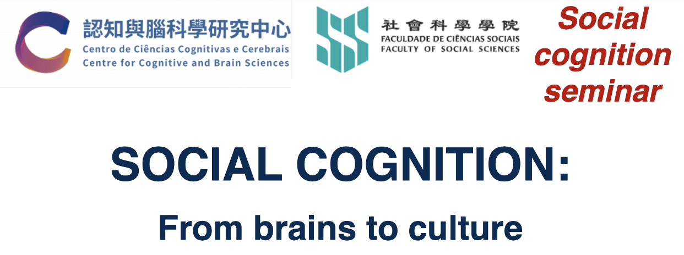



Ch 14 From Affect to Social Cognition
ANDlab social_cognition_seminar
Haiyan Wu

Slide 2
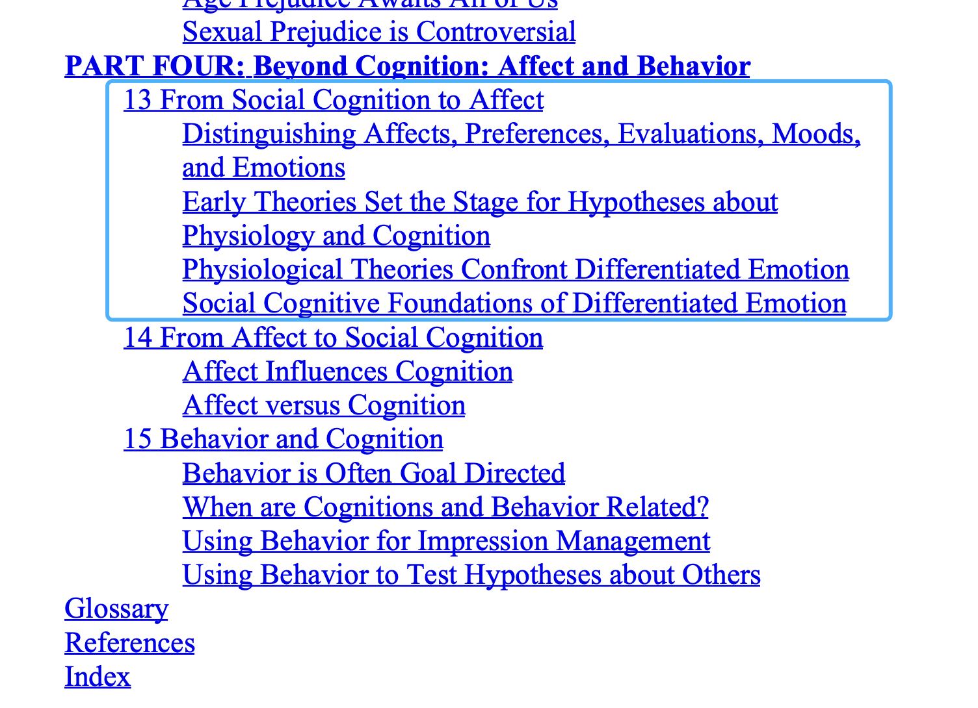
Recap

Slide 3
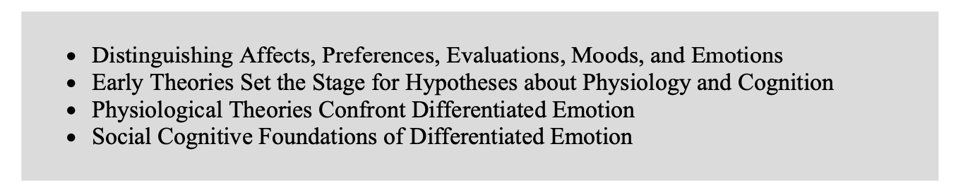
Structure

Slide 4
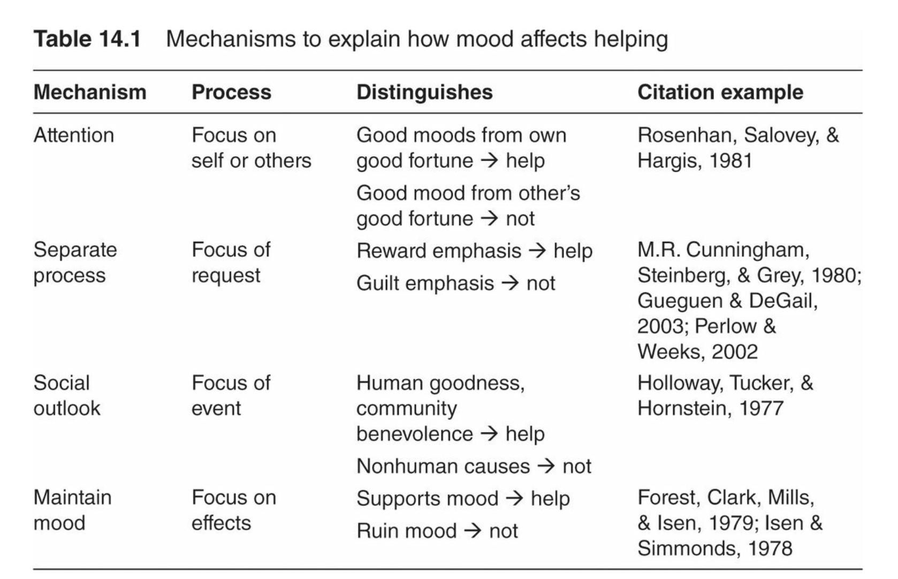
Affect Influences Cognition
(i) Mood and Helping
Accounts
Mood can alter one’s focus of attention such that one considers mainly oneself or other people
separate process view, people in a positive mood will help mainly if the request emphasizes the rewards of helping rather than a guilt-inducing obligation to help
people are cheered by an interpersonal event, they are more likely to help because they focus on human goodness or community benevolence; an improved social outlook enhances prosocial value
mood maintenance, so cheerful people are less likely to help if it would ruin their mood

Slide 5
Affect Influences Cognition
(ii) Mood and memory
Accounts
people recall positive material in positive moods and sometimes recall negative material in negative moods
Mood Congruence
depressed people (compared to controls) underremember positive words and phrases or overrecall negative ones (Ingram, Smith, & Brehm, 1983).
people often regulate negative moods by reframing past negative events or by retrieving positive memories to counteract the bad mood, resulting in mood-incongruency effects for negative moods. Also, when people reflect on their moods, they tend to recall mood-incongruent events (McFarland & Buehler, 1998).

Slide 6


Affect Influences Cognition
(ii) Mood and memory
Mood State-Dependent Memory
the congruence between the mood context in which material is learned and the mood context in which material is retrieved.
-> something learned while intoxicated is easier to remember while intoxicated than while sober

Slide 7
Affect Influences Cognition
(iii) Mood and Judgment
cheery mood-based benevolence effects
Is the converse true? Do unhappy people dislike everything
-> Politicians who smile can put their viewers in a good mood, and this translates to positive feelings about the politician;
Mood researchers are moving beyond valence and arousal to complex emotions.

Slide 8
Affect Influences Cognition
(iii) Mood and Judgment
anger and fear – have distinct effects on judgment
-> Fear increases the perceived risk of terrorist attacks, whereas anger decreases the perceived possibility
fearful people are pessimistic and see increased risks
anger makes people optimistic and risk-seeking
Anger facilitates automatic prejudices, whereas sadness neutralizes intergroup bias

Slide 9
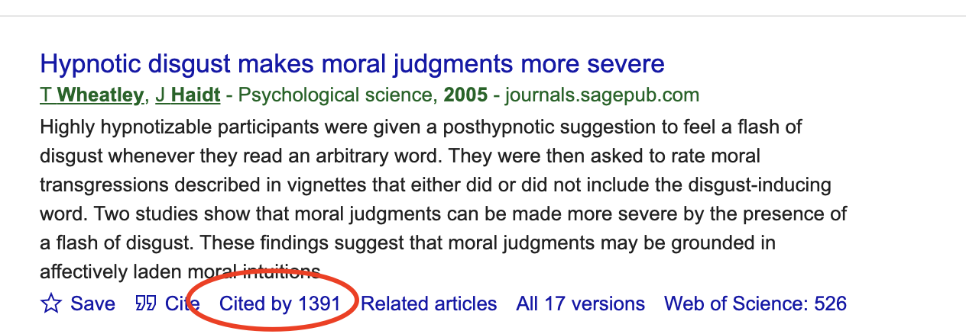
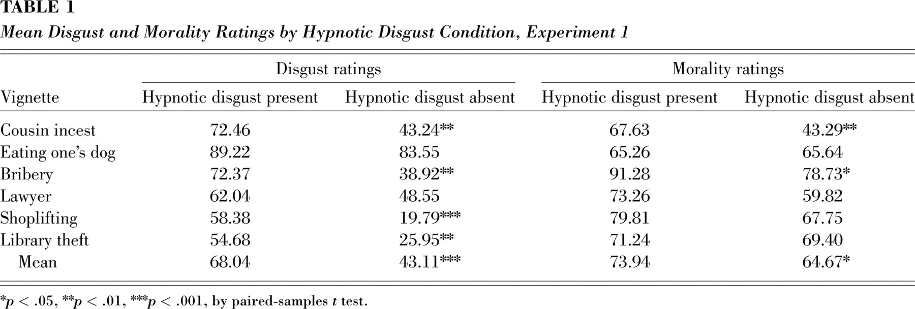
Affect Influences Cognition
(iii) Mood and Judgment
“Moral emotions and intuitions drive moral reasoning, just as surely as a dog wags its tail” (Haidt, 2001, p. 830).

Slide 10
Open questions?
some people are more emotionally reactive than others. For example, an early family environment characterized by stress (e.g., harsh parenting) can carry over to dampen the typical amygdala response to fearful and angry faces
early experiences shape neural responses to emotional stimuli, and cognitive processes (labeling) can regulate (or fail to regulate) these reactions

Slide 11
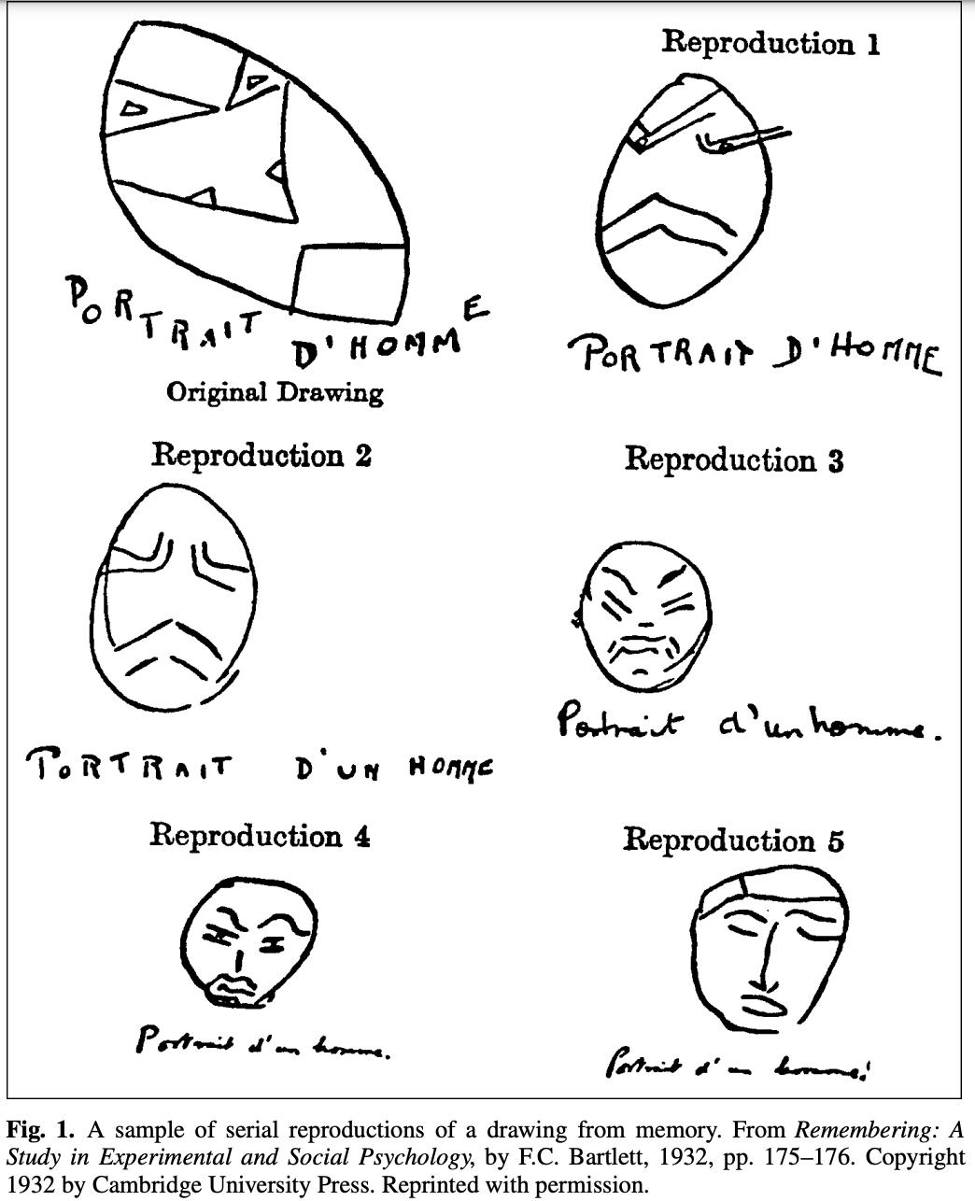
Affect Influences Cognition
(v) Mood and Decision-Making Style
positive moods apparently are associated with factors conducive to creativity, and people will even claim a bad mood as an excuse for failure (Baumgardner, Lake, & Arkin, 1985);
happy people emerge as especially flexible decision makers.
Sad people, on the other hand, are more likely to be careful and to mull over their decisions. For example, sad people feel alerted that something is amiss, so they correct their stereotypes
focus on details, neglecting the big picture (Gasper & Clore, 2002)

Slide 12
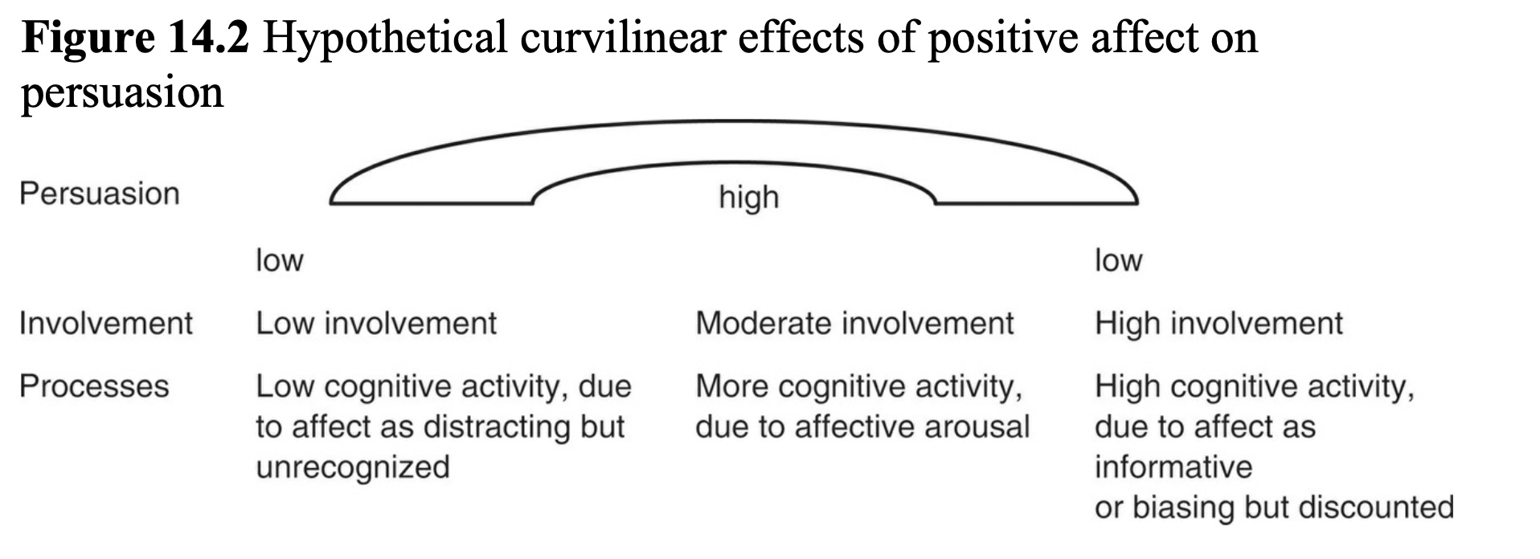
Mood and Persuasion
cheerful people are more compliant with persuasive communications, whereas angry or uncomfortable people are generally less compliant.

Slide 13
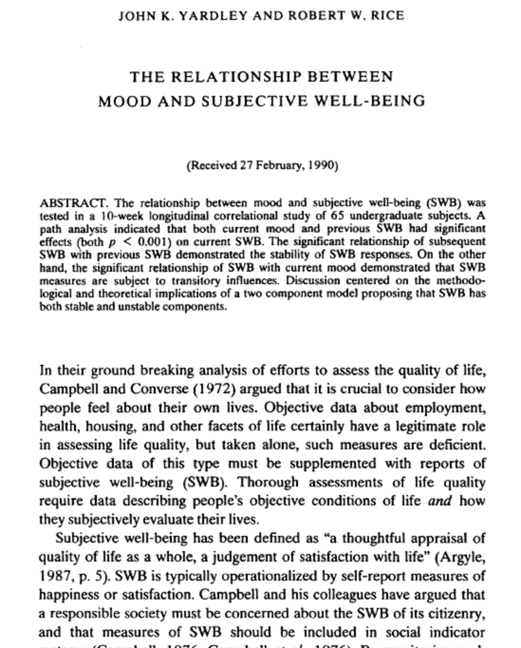
Mood and Well-Being
Cheerful people have a variety of advantages, as we have seen. These culminate in a wide array of general life outcomes: Being happy improves health, friendships, marriage, income, and performance

Slide 14
Affect versus Cognition

Slide 15
The Separate-Systems View
Affective reactions are primary. Evaluations are made and then justified; decisions are based on preference rather than computation. (Romantic involvements are a prime example of not choosing based on a cognitive list of pros and cons.)
Affect is basic. Evaluation is a major and universal component of virtually all perception and meaning. It is difficult to understand something without evaluating it.
Affective reactions are inescapable. They are demandingly present in a way that simple knowledge is not. (Attraction is harder to ignore than the other person’s career plans.)
Affective reactions tend to be irrevocable, in contrast to cognitive judgments. One’s feelings cannot be wrong, but one’s beliefs can be; hence, affect is less vulnerable to persuasion than cognition. (As parents of adolescents constantly discover, other people’s feelings of love and anger do not respond well to counterargument.)
Affect implicates the self
Affective judgments are difficult to verbalize.
Affective reactions may not depend on cognition.
Affective reactions may be separated from content knowledge.

Slide 16
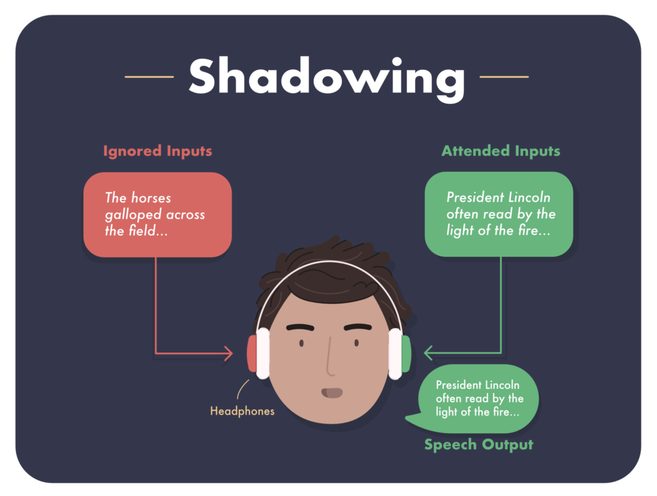
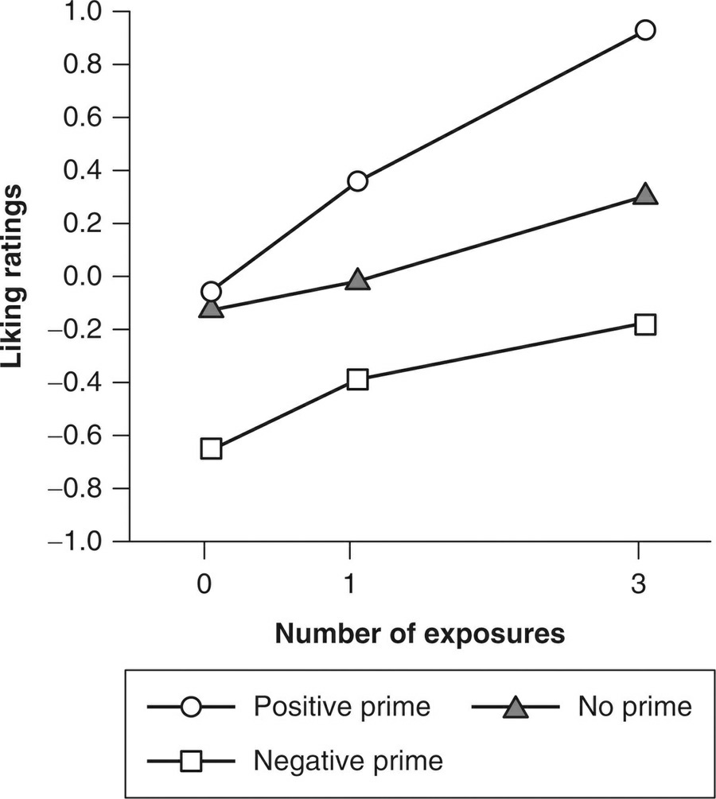
The Separate-Systems View
Evidence from Mere Exposure Research
dichotic listening task

Slide 17
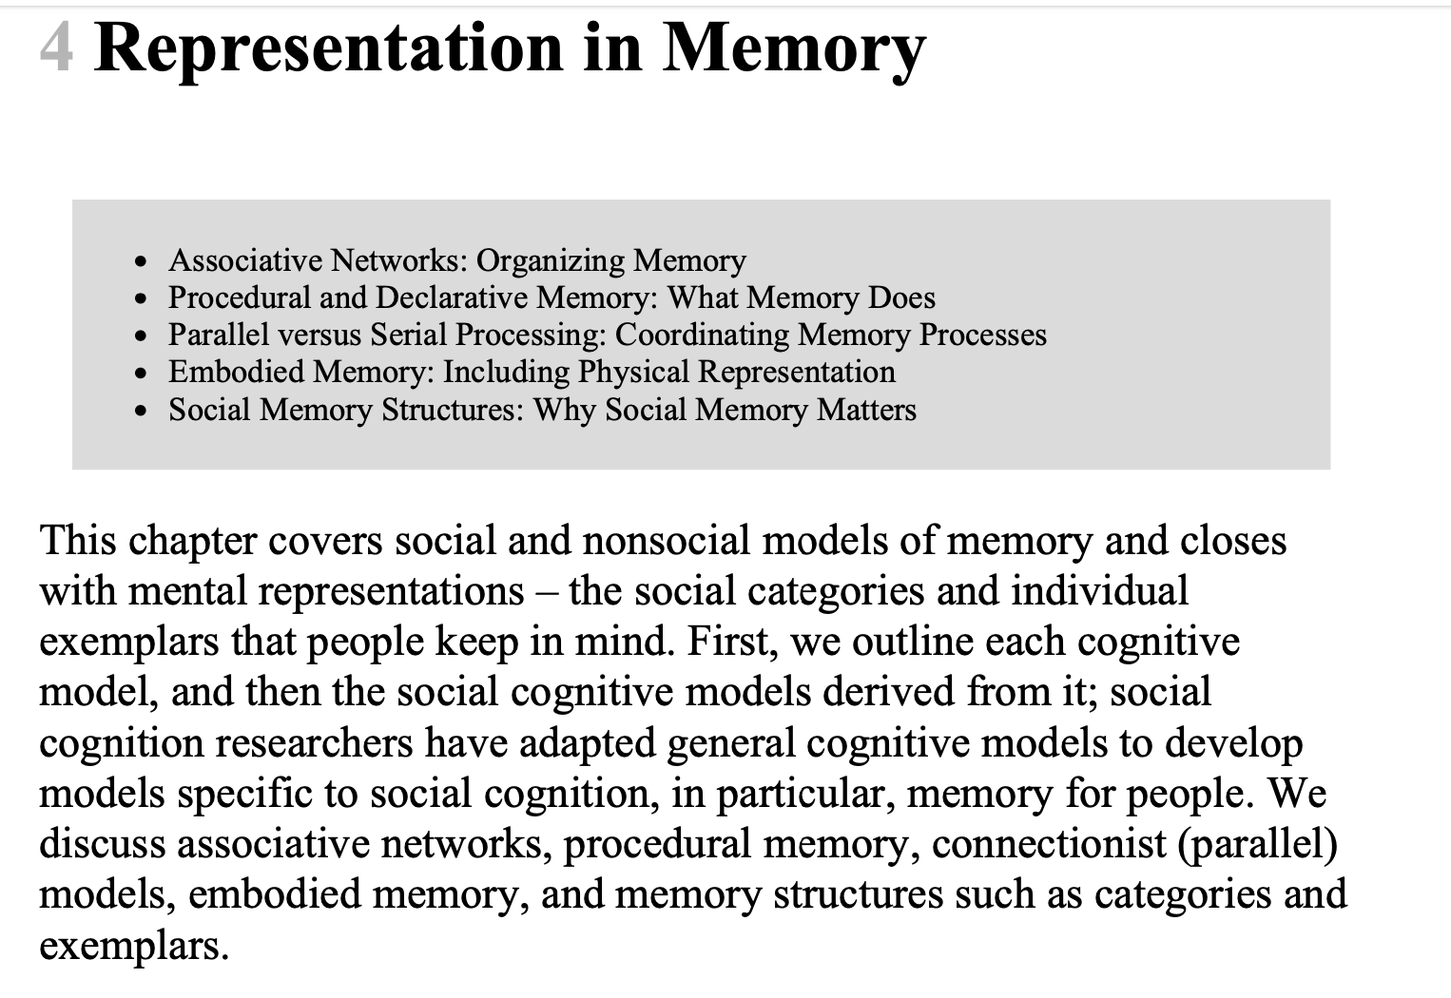
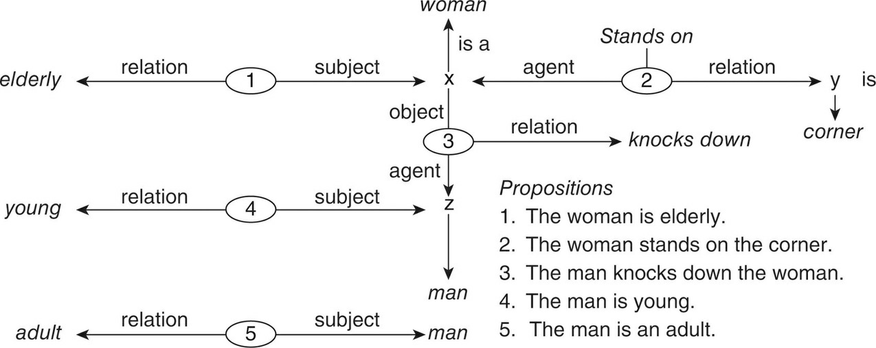
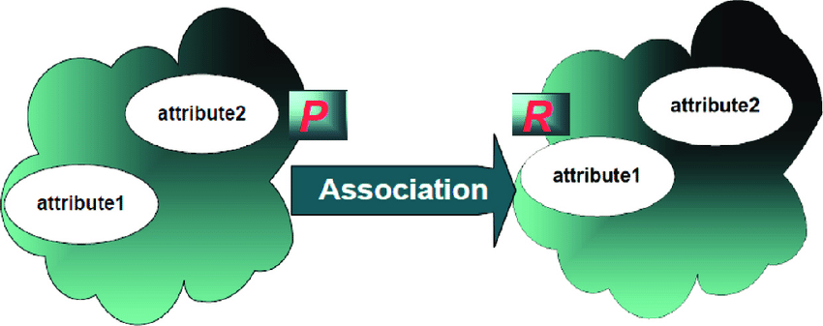
The Separate-Systems View
Evidence from Person Perception, Attribution, and Attitude Research
as you are forming an impression of someone at a party, your affective response is likely to occur independently of your later ability to remember details about the person.
Associative Networks: Organizing Memory
exact format of the representation is called a memory code.
In associative memory models, activation spreads: Recall starts at one point (e.g., the woman) and moves out along links between the nodes (A. M. Collins & Loftus, 1975).

Slide 18
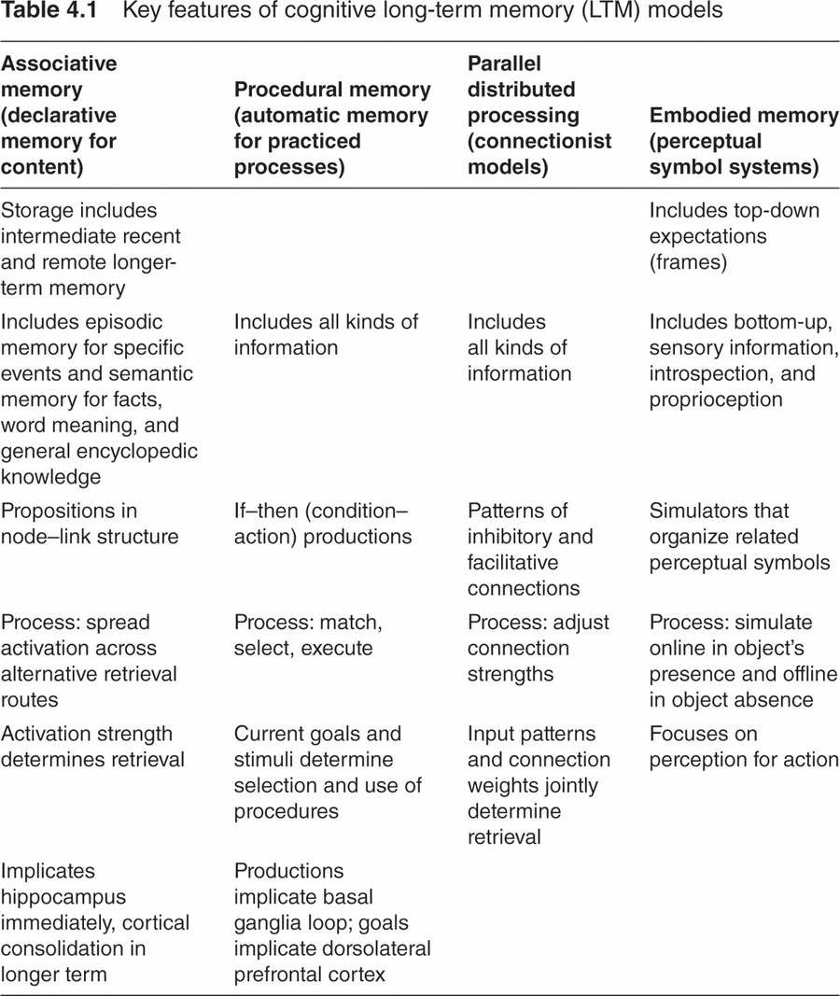

Slide 19
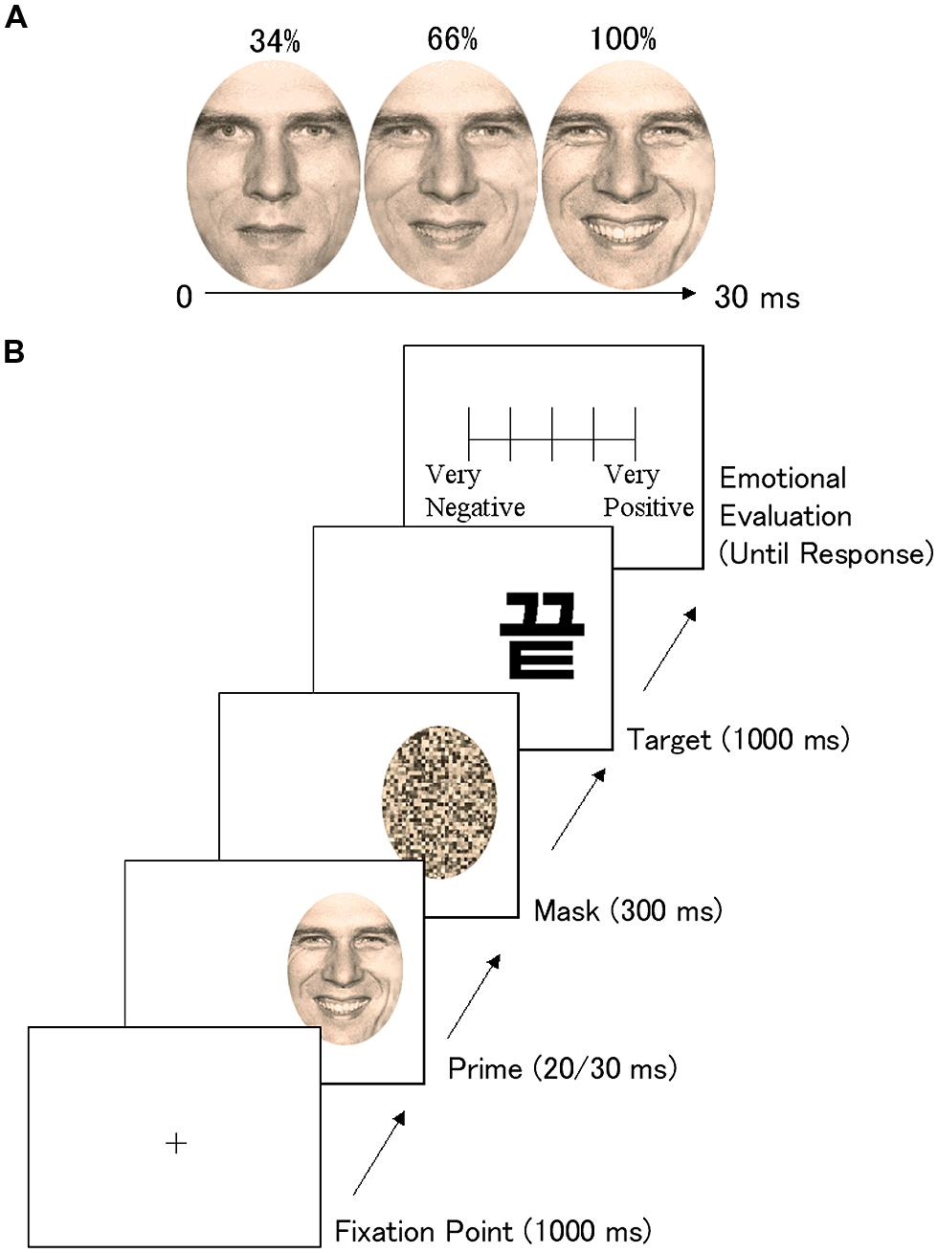
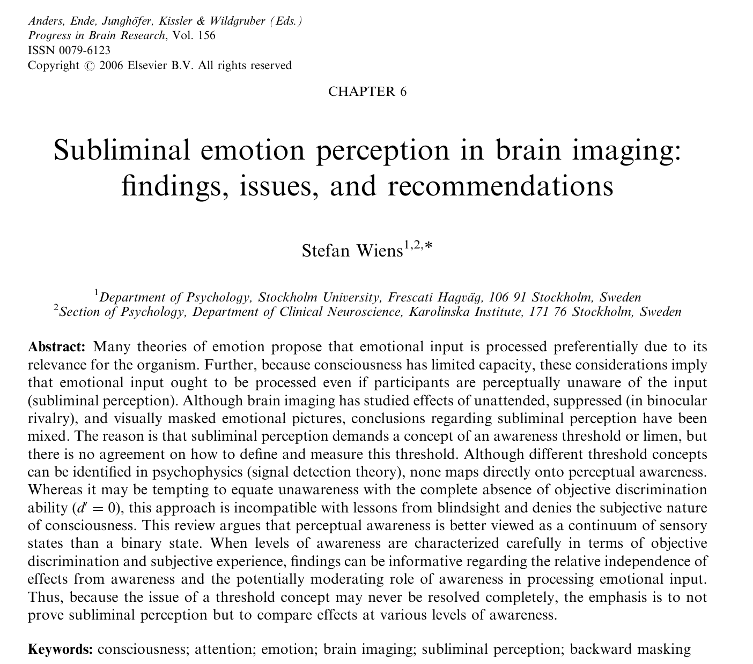

The Separate-Systems View
Coordinated physiological responses associated with emotion can be triggered without either sophisticated information processing or awareness of its objects. Thus, emotions are non-cognitive (i.e. cognitions are not an integral component of emotion).

Slide 20
The Separate-Systems View Objections
Emotion concerns the person’s own experience as subject or origin rather than focusing on the object itself out there. Emotion tends to influence perceived “reality,” whereas thinking to a greater extent accommodates to reality.
Emotion views the target as important for its relationship to the person, but intellective cognition emphasizes an object’s relationship to other external objects. Emotion involves physiological experiences, not just environmental inputs. Emotion regulates the intensity and style of behavior rather than the goal-directed efficiency of behavior. Emotion is experienced passively or as a reaction to the stimulus, but people experience themselves as the source of intellective cognition. Emotion commits one to action more than does the cost–benefit calculation of intellective cognition. Emotion norms are moral and aesthetic, whereas intellective norms are rational. Emotion helps define the self, rather than the world
the distinctions are less important than the possibility of subsuming both cognition and affect within one mental system;
Emotions are noncognitive in the first sense only, being nonintellective cognition – that is, being more value-laden, intuitive, and irrational

Slide 21
When thinking about the future, it is always good to know where one came from……

Slide 22
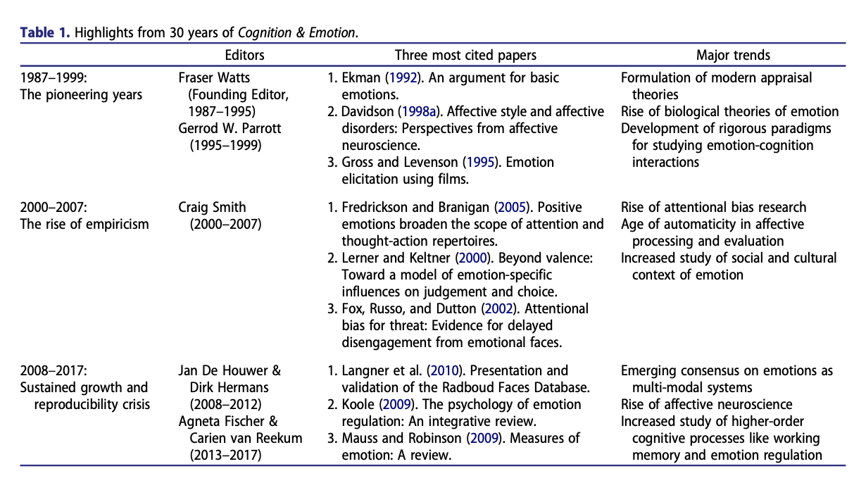

Slide 23
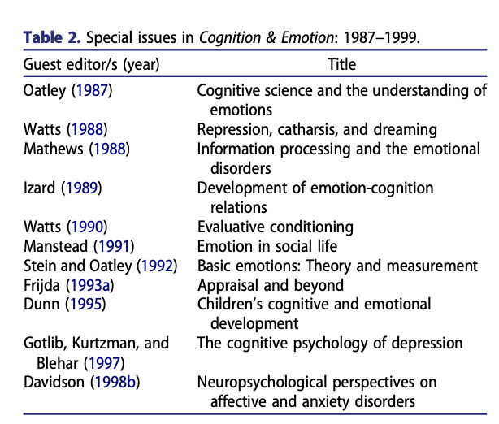

Slide 24
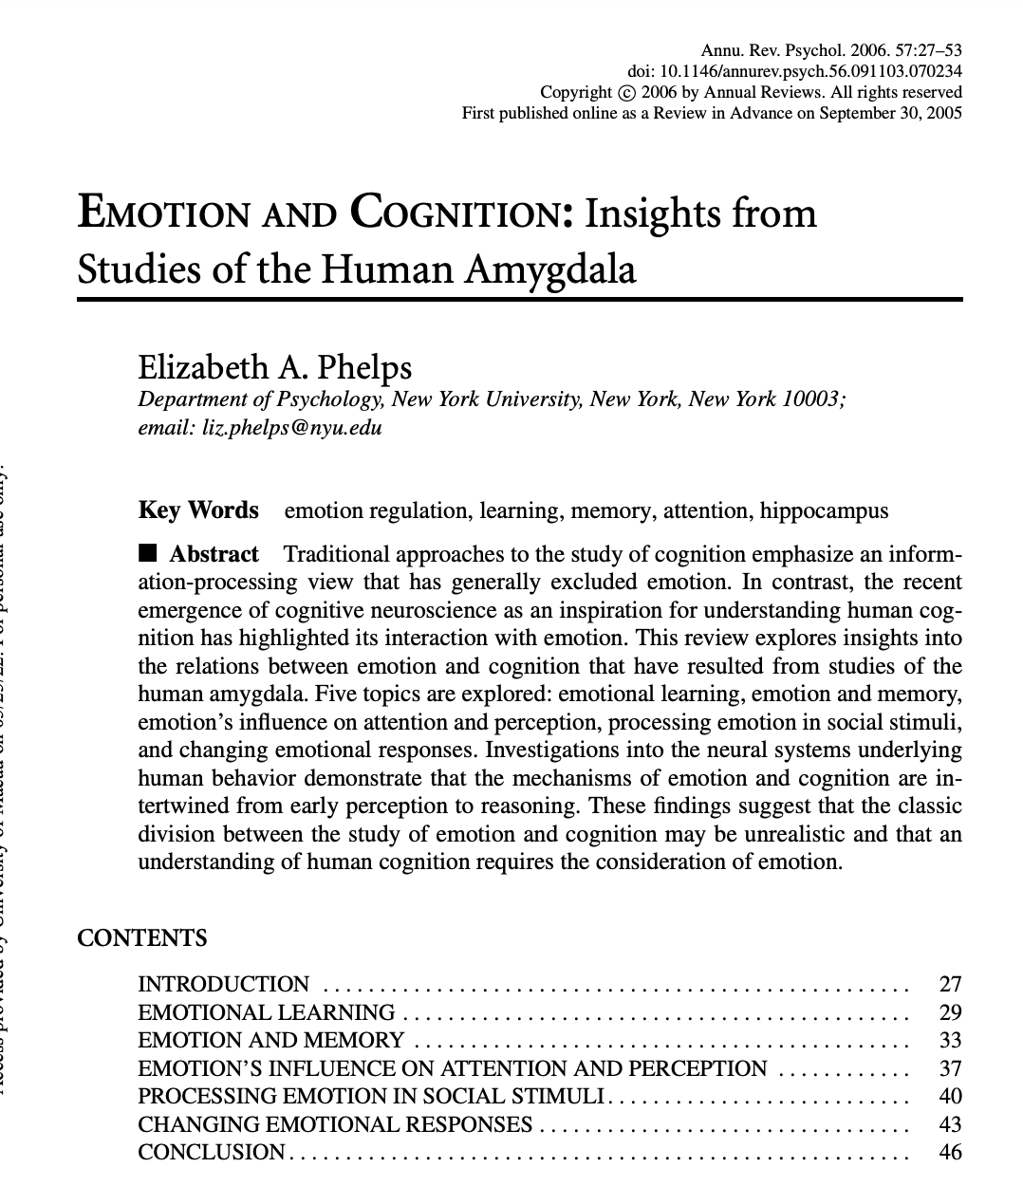
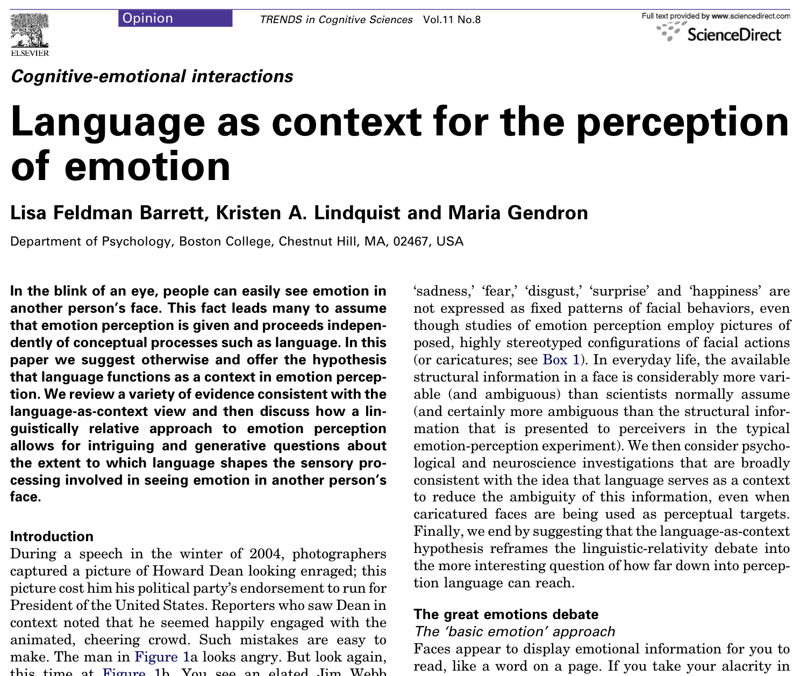

Slide 25
Questions?
1. Do emotion words anchor the conceptual system for emotion and support emotion-category acquisition in infants?
2. How does language shape the sensory-based (bottom-up) versus. memory-based (top-down) processes supporting the perception of emotion?
3. Does the influence of language on emotion perception vary with context or task demands?
4. Do individual (or cultural) differences in emotion vocabulary translate into differences in structure and content of the conceptual system for emotion and into differences in emotion perception?
5. Can emotion perception be improved by language-based training programs?

Slide 26
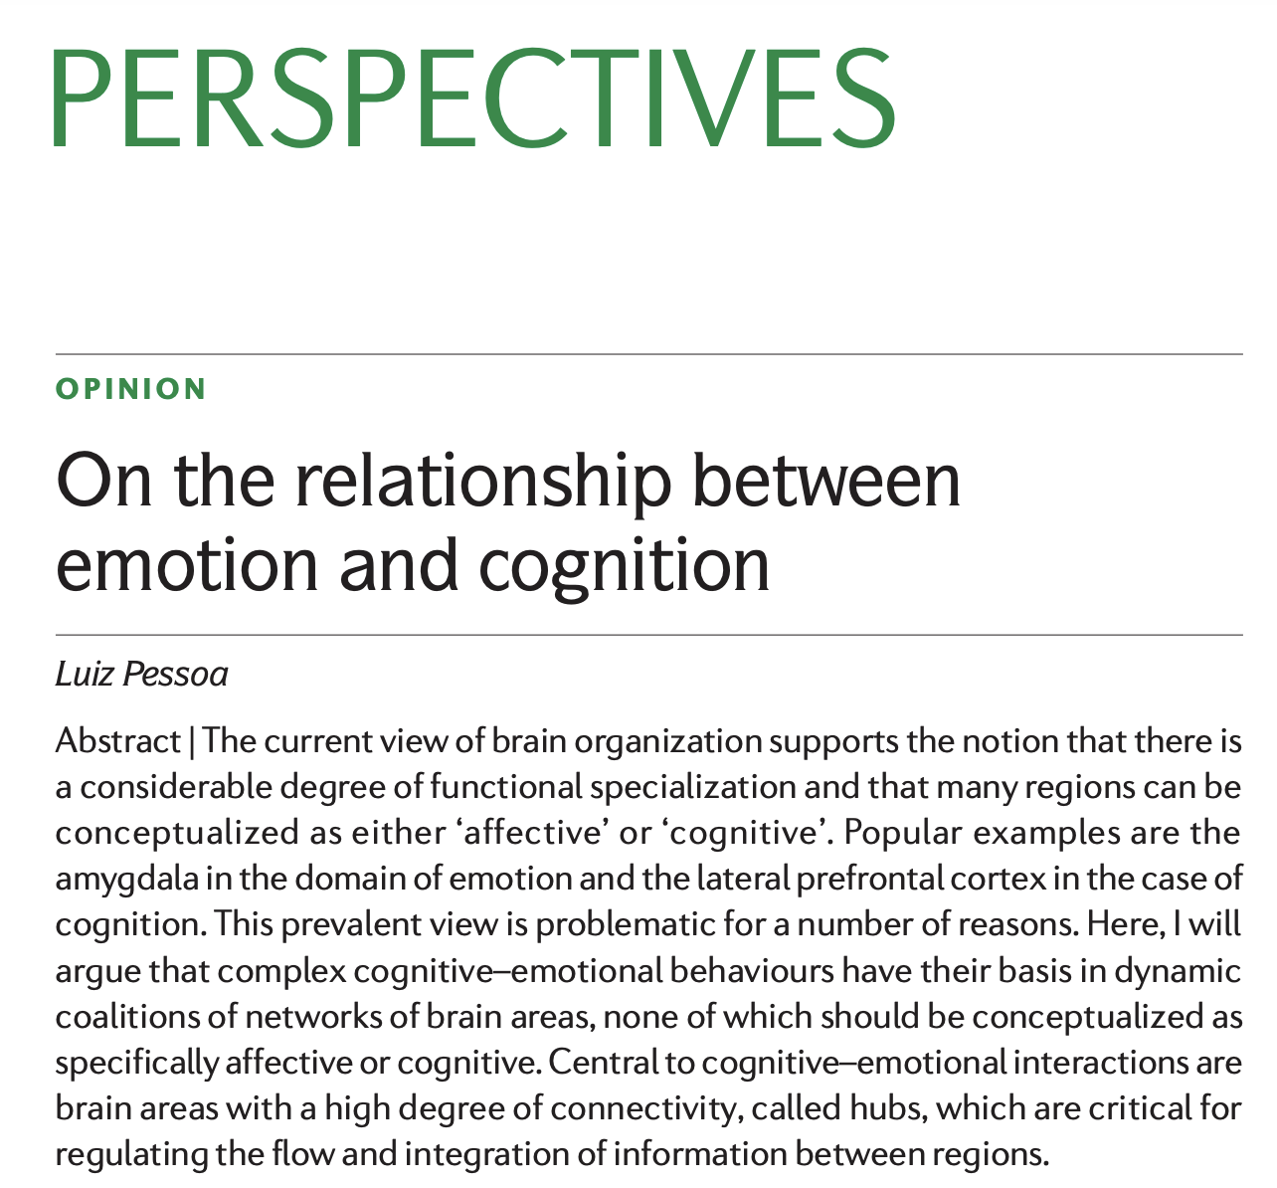
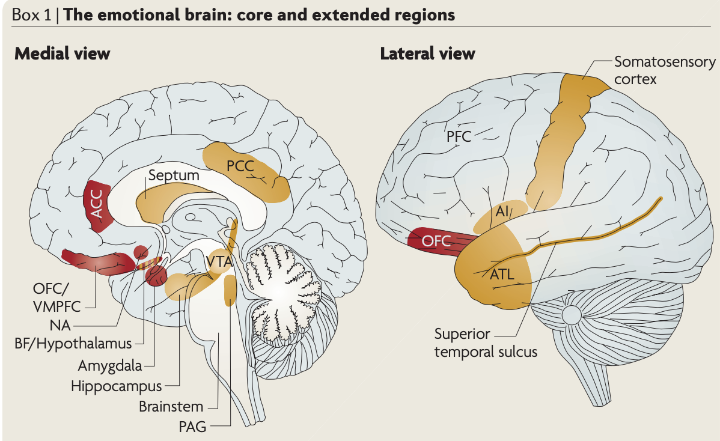

Slide 27
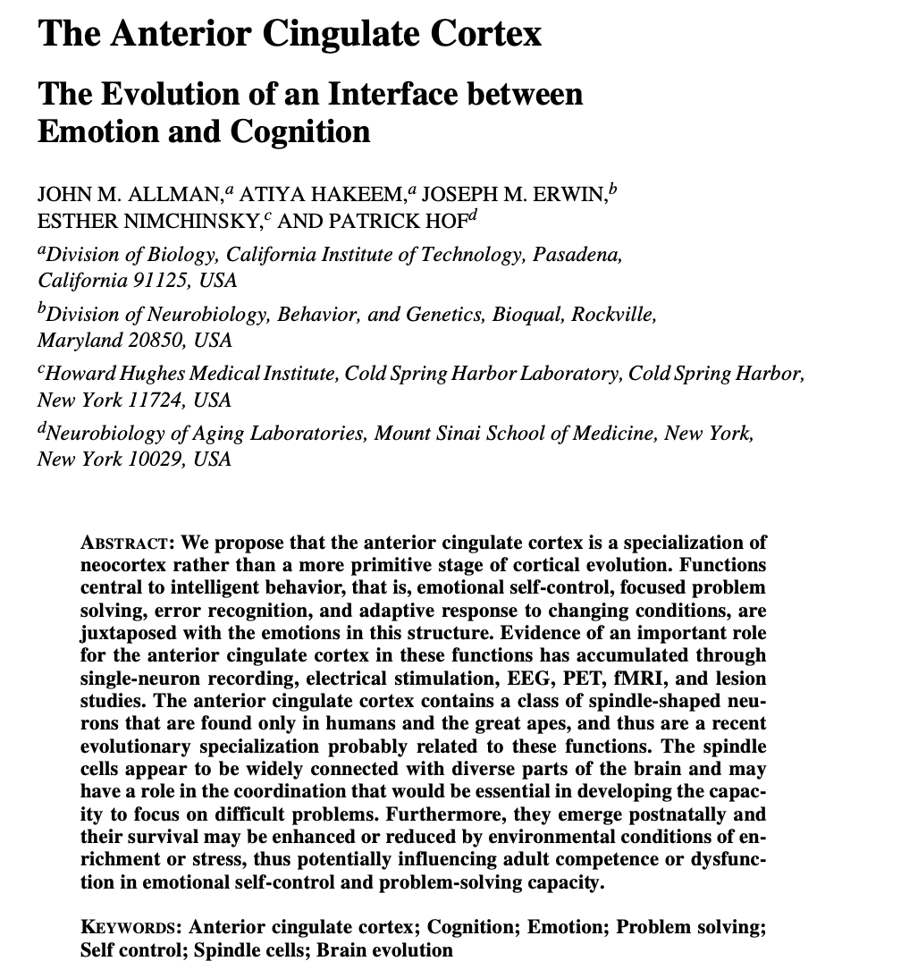
how is that processes generally considered ‘cognitive’ are altered by ‘affect’ and vice versa?
how do the neural mechanisms of emotion and cognition interact to allow adaptive learning and choices?
how might our emerging understanding of the interaction of emotion and cognition be extended to topics that are important outside the laboratory?

